Slide 1
Lecture 4 — energy generation
PHY199-RAP · Energy in the 21st Century
Dr. Salvatore Rappoccio

Slide 2
Nuclear power

Slide 3
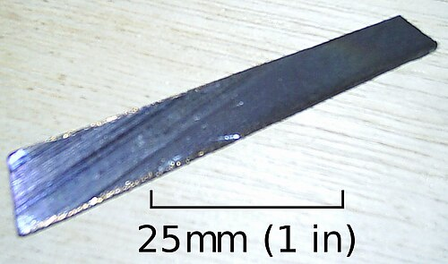
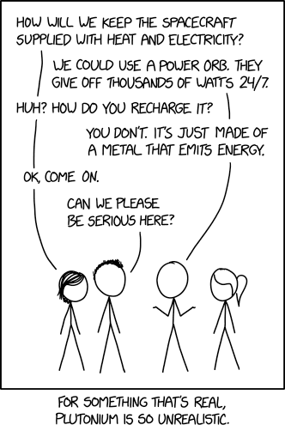
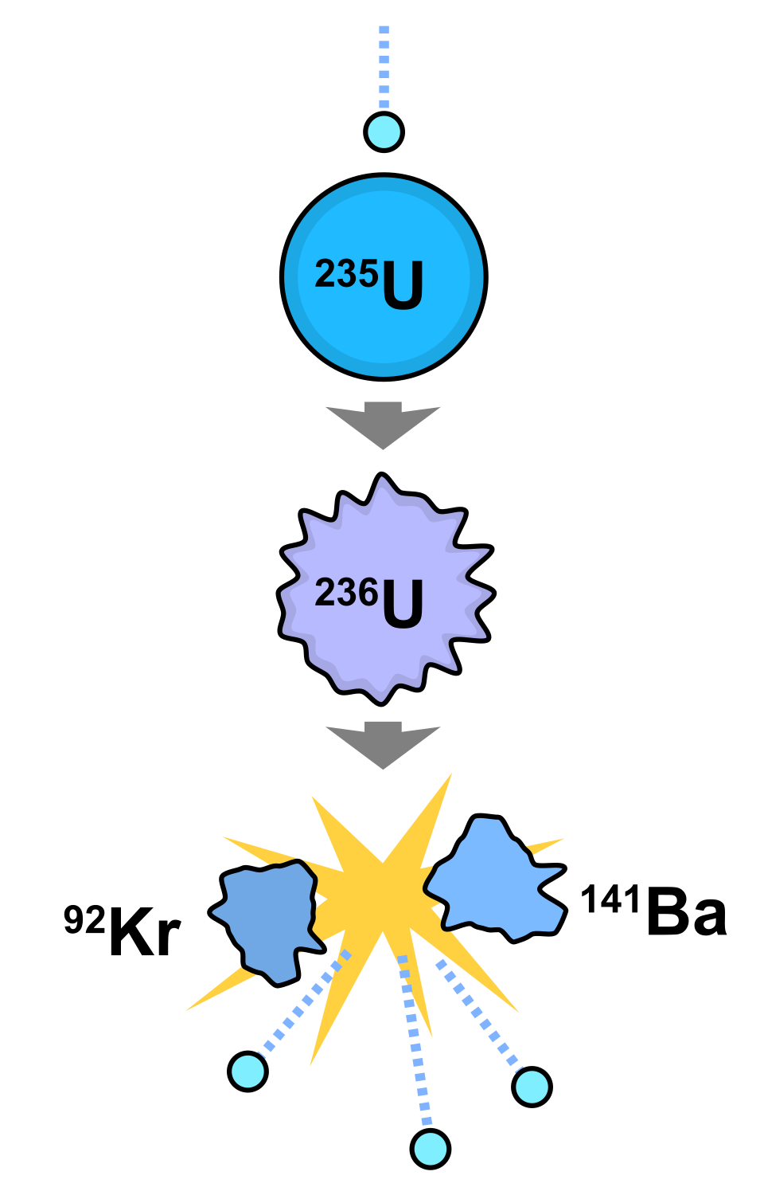
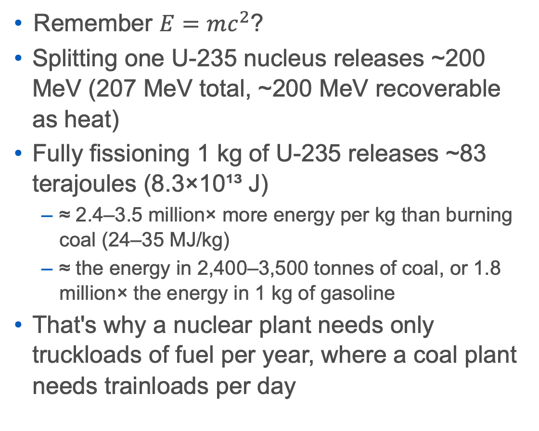
Nuclear Fission
Remember $E=mc^{2}$?
Splitting one U-235 nucleus releases ~200 MeV (207 MeV total, ~200 MeV recoverable as heat)
Fully fissioning 1 kg of U-235 releases ~83 terajoules (8.3×10¹³ J)
  ≈ 2.4–3.5 million× more energy per kg than burning coal (24–35 MJ/kg)
  ≈ the energy in 2,400–3,500 tonnes of coal, or 1.8 million× the energy in 1 kg of gasoline
That's why a nuclear plant needs only truckloads of fuel per year, where a coal plant needs trainloads per day
https://en.wikipedia.org/wiki/Uranium-238
https://xkcd.com/2115/
Sources: en.wikipedia.org/wiki/Nuclear_fission · en.wikipedia.org/wiki/Uranium-235 · en.wikipedia.org/wiki/Energy_density

Slide 4
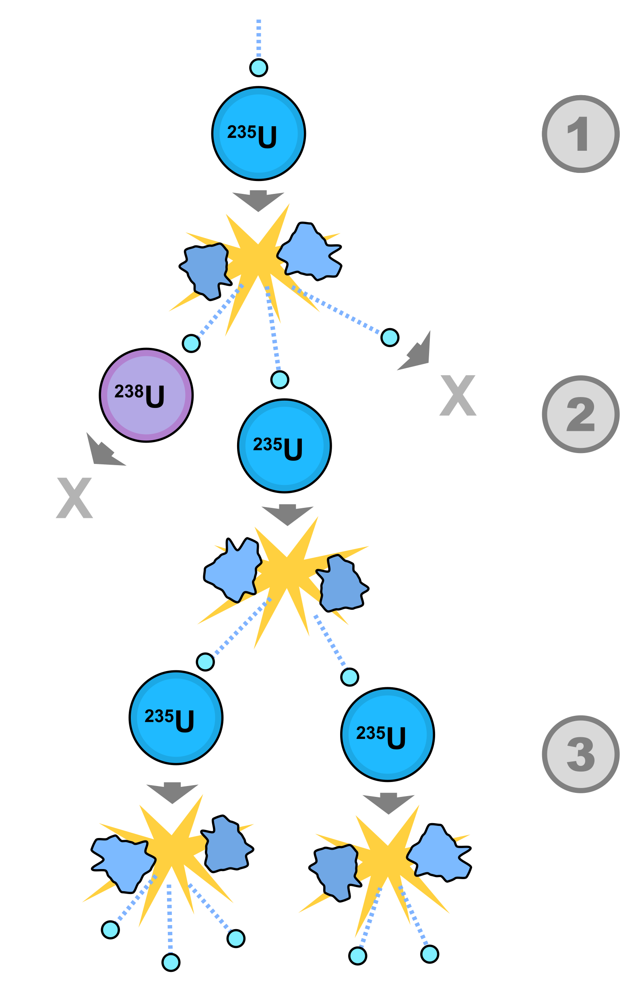
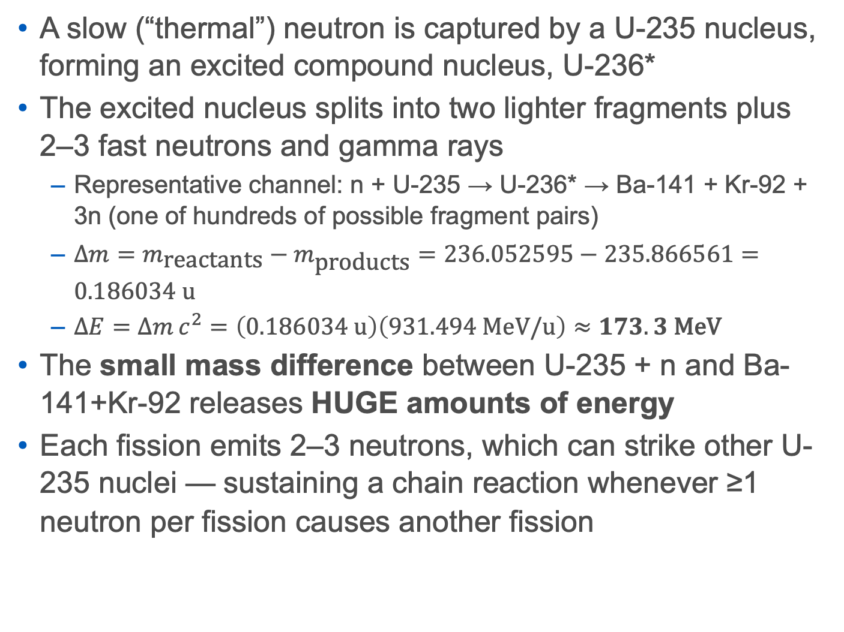
U-235 Reaction
A slow (“thermal”) neutron is captured by a U-235 nucleus, forming an excited compound nucleus, U-236*
The excited nucleus splits into two lighter fragments plus 2–3 fast neutrons and gamma rays
  Representative channel: n + U-235 → U-236* → Ba-141 + Kr-92 + 3n (one of hundreds of possible fragment pairs)
  $Δm=m_{\text{reactants}}−m_{\text{products}}=236.052595−235.866561=0.186034\text{ u}$
  $ΔE=Δm c^{2}=\left(0.186034\text{ u}\right)\left(931.494\text{ MeV/u}\right)≈173.3\text{ MeV}$
The small mass difference between U-235 + n and Ba-141+Kr-92 releases HUGE amounts of energy
Each fission emits 2–3 neutrons, which can strike other U-235 nuclei — sustaining a chain reaction whenever ≥1 neutron per fission causes another fission
Sources: en.wikipedia.org/wiki/Nuclear_fission · en.wikipedia.org/wiki/Uranium-235
Image: “Fission chain reaction.svg”, User:Fastfission — public domain — commons.wikimedia.org/wiki/File:Fission_chain_reaction.svg

Slide 5
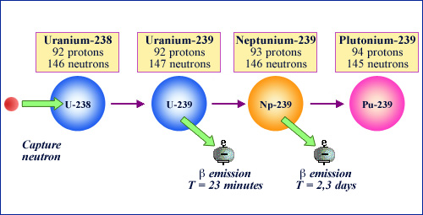
U-238 to Pu-239 Reaction
U-238 is 99.27% of natural uranium. It is “fertile,” not fissile — it won't sustain a chain reaction, but it can absorb a neutron
Step 1 — neutron capture: n + U-238 → U-239
Step 2 — beta decay: U-239 → Np-239 + e⁻ + antineutrino (half-life 23.45 min)
Step 3 — beta decay: Np-239 → Pu-239 + e⁻ + antineutrino (half-life 2.356 days)
The result, Pu-239, is fissile (half-life ~24,100 yr) and can itself fuel a reactor or a weapon
This exact sequence is how “breeder” reactors convert abundant, non-fissile U-238 into usable fuel (see Slide 7)
https://radioactivity.eu.com/articles/nuclearenergy/plutonium_239_formation
Claude organized this slide
Sources: en.wikipedia.org/wiki/Plutonium-239 · en.wikipedia.org/wiki/Uranium-238 · en.wikipedia.org/wiki/Isotopes_of_uranium · en.wikipedia.org/wiki/Isotopes_of_neptunium
Image not added: “Plutonium ring.jpg” was flagged NON-FREE/CHECK by the fetch script (license shows only “Attribution”, no confirmed license URL) — verify rights on Commons before using it: commons.wikimedia.org/wiki/File:Plutonium_ring.jpg

Slide 6
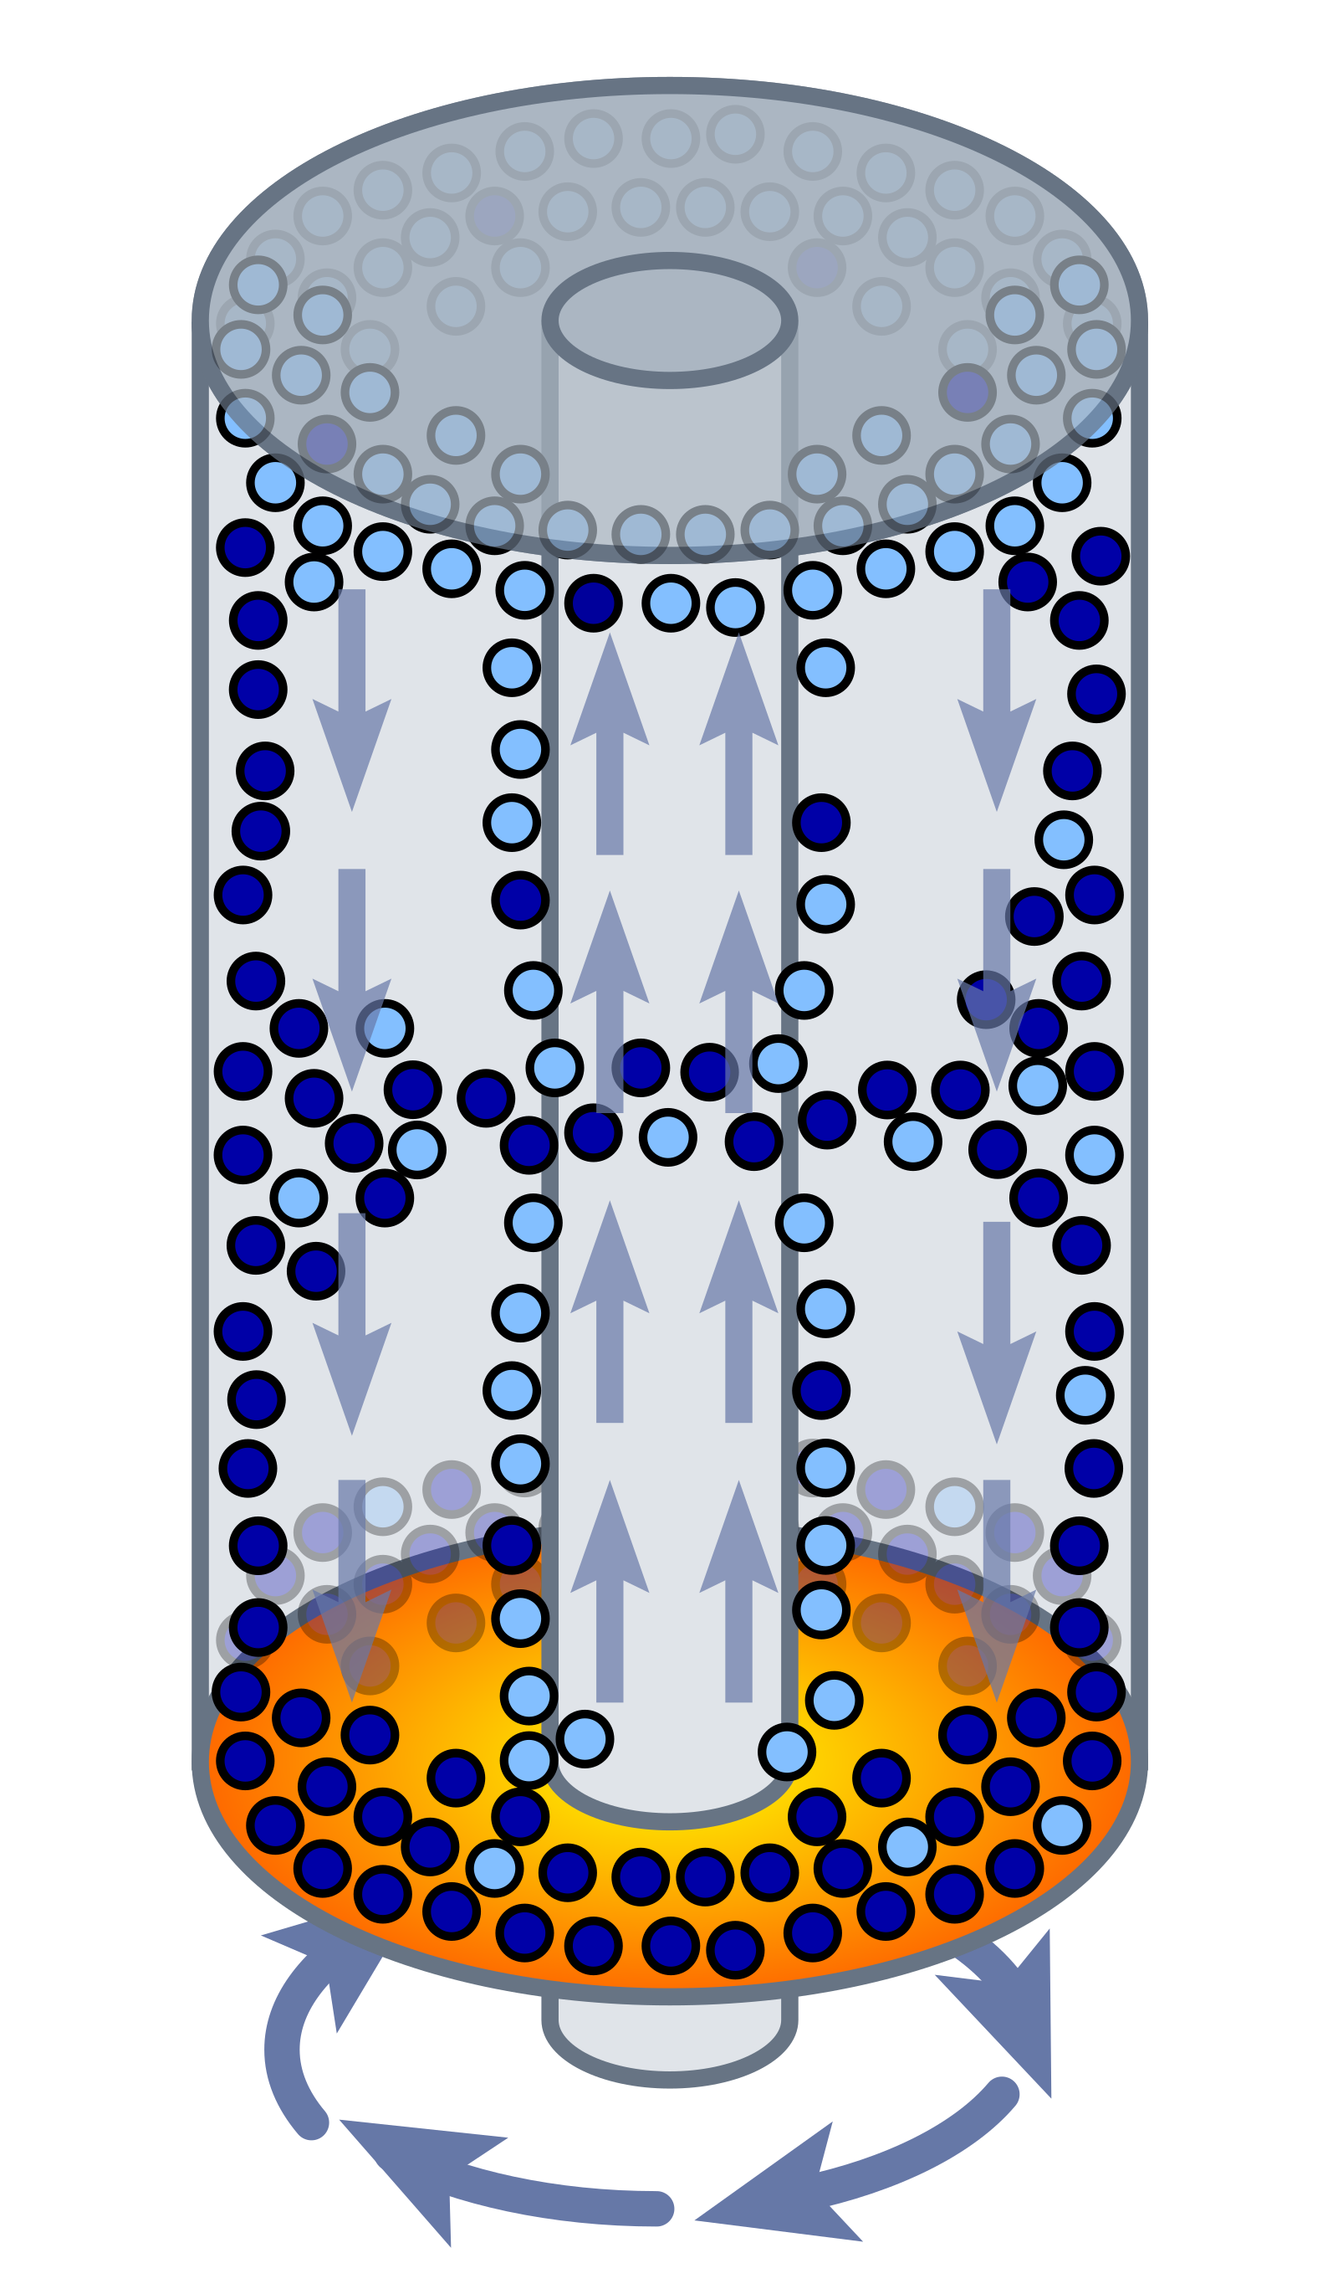
Enriching Uranium
Natural uranium is ~0.72% U-235 (fissile) and ~99.27% U-238 (fertile) — too dilute in U-235 for most reactors
Uranium is converted to uranium hexafluoride gas (UF₆), then spun at high speed in gas centrifuges: heavier U-238 drifts outward, lighter U-235 concentrates near the axis
  Each stage shifts the ratio only slightly (separation factor ≈ 1.3), so thousands of centrifuges are linked in cascades
  Modern centrifuges use ~40–50 kWh per separative work unit (SWU) — far less than old gaseous diffusion (~2,400–2,500 kWh/SWU)
Enrichment levels of U-235 :
  reactor fuel (low) ~3–5%
  advanced/small reactors 5–20%
  highly enriched ≥20%
  weapons-grade typically ≥85–90%
Leftover “depleted” uranium (mostly U-238) is used for radiation shielding, armor-piercing rounds, and breeder-reactor “blanket” fuel
Diagram of the principles of a Zippe-type gas centrifuge with U-238 represented in dark blue and U-235 represented in light blue.
Sources: en.wikipedia.org/wiki/Enriched_uranium · en.wikipedia.org/wiki/Uranium-235 · en.wikipedia.org/wiki/Gas_centrifuge
Image: “Zippe-type gas centrifuge.svg” — public domain — commons.wikimedia.org/wiki/File:Zippe-type_gas_centrifuge.svg
https://en.wikipedia.org/wiki/Zippe-type_centrifuge
Claude organized this slide

Slide 7
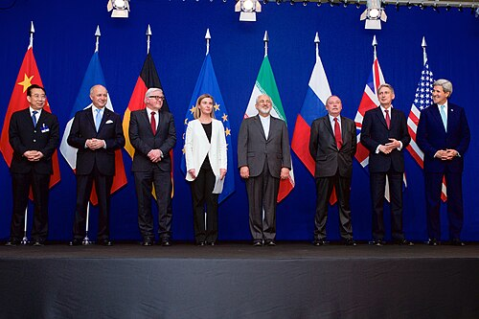
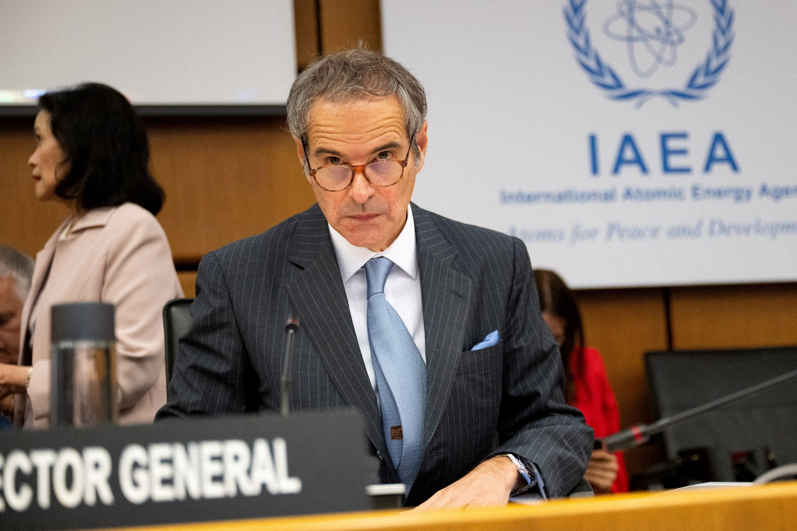
In the news : Iran nuclear program
Source: Wikipedia - Nuclear program of Iran
  1957 - US-Iran "Atoms for Peace" civil nuclear deal
  1970 - Iran signs Non-Proliferation Treaty
  1979 - Revolution stalls program; Iran-Iraq War damages Bushehr
  2002 - Natanz enrichment site, Arak reactor exposed
  2003-2005 - IAEA finds non-compliance; EU talks stall
  2005-2010 - UN sanctions; Stuxnet cyberattack hits centrifuges
  2009 - Secret Fordow enrichment site revealed
  2010-2012 - Four Iranian nuclear scientists assassinated
  2015 - JCPOA signed; enrichment capped at 3.67%
  2018 - US (Trump) withdraws from JCPOA; sanctions reinstated
  2019-2021 - Breaches: enrichment climbs 5% -> 20% -> 60%
  2020 - Top scientist Mohsen Fakhrizadeh assassinated
  2023 - IAEA detects uranium enriched to 84%
  2024 - Israeli strikes hit Parchin weapons-research site
  2025 (Apr-May) - US-Iran talks in Oman, Italy
  2025 (Jun) - Israel/US strike Natanz, Fordow, Isfahan ("Twelve-Day War")
  2025 (Jul) - IAEA inspectors leave Iran
  2025 (Sep) - UN "snapback" sanctions reimposed
  2026 - Sites still inaccessible; stockpile unverified; ceasefire talks (Pakistan-mediated) stalled
Negotiations about Iranian Nuclear Program, the Ministers of Foreign Affairs and Other Officials of the P5+1 and Ministers of Foreign Affairs of Iran and EU in Lausanne, April 2015
International Atomic Energy Agency (IAEA) Director General Rafael Grossi waits for an emergency meeting of the agency’s Board of Governors to discuss the situation in Iran following the U.S. attacks on the country’s nuclear facilities, at the IAEA headquarters in Vienna, Austria, June 23, 2025. REUTERS/Elisabeth Mandl/File Photo
And that’s why diesel is >$6/gallon
Claude organized this slide

Slide 8
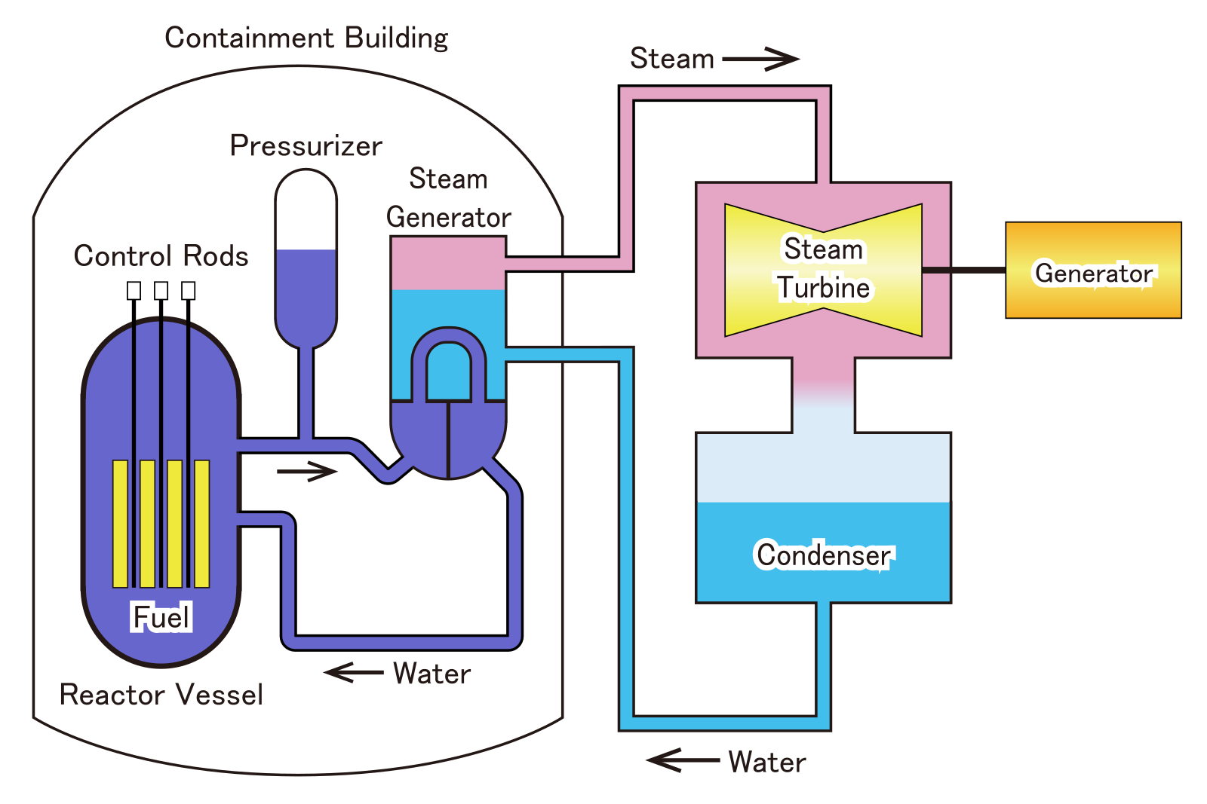
Types of fission reactors
Pressurized-water reactor (PWR) — pressurized water can't boil; heats a separate steam loop via a steam generator. ~74% of world reactors
Boiling-water reactor (BWR) — water boils directly in the vessel, driving the turbine with no separate loop. ~18%
Pressurized heavy-water reactor (PHWR/CANDU) — heavy water (D₂O) moderator absorbs so few neutrons it runs on unenriched natural uranium. ~11%
Gas-cooled reactor (GCR/AGR) — CO₂-cooled, graphite-moderated, higher thermal efficiency. ~3%
RBMK — Soviet graphite-moderated, water-cooled design (the Chernobyl type); only a handful remain. ~3%
Fast breeder reactor (FBR) — unmoderated; fast neutrons + liquid-metal (sodium) coolant convert U-238 → Pu-239 faster than fuel is consumed (breeding ratio > 1). <1% today — e.g. Russia's BN-600/BN-800, India's PFBR (first criticality 2026)
Small modular reactors (SMRs) — compact, factory-built designs of varying types; mostly still emerging
Sources: en.wikipedia.org/wiki/Nuclear_reactor · en.wikipedia.org/wiki/Breeder_reactor
Images: “Pressurized Water Reactor 01.svg” (Σ64, CC BY 4.0) · “Fast Breeder Reactor diagram.jpg” (thomick, CC BY-SA 3.0) — commons.wikimedia.org

Slide 9
Health and Environmental Risks of Nuclear Power
If you’re next to an active nuclear fuel rod, you’re going to have a very bad day because of radiation poisoning
Similarly if you’re in the middle of the Large Hadron Collider (where I work), you’ll ALSO have a very bad day
We have expansive set of rules and guidelines for this, focused on three factors:
  Time (of exposure)
  Distance (to source of radiation)
  Shielding (what is between you and the source)
To understand the risks, you need to understand what radiation is

Slide 10
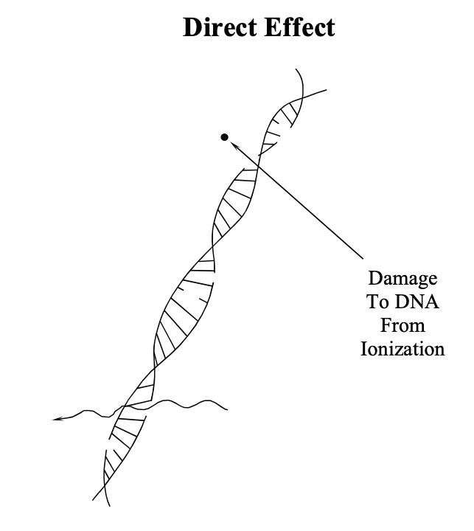
Health and Environmental Risks of Nuclear Power
Source: NRC - Biological Effects of Radiation
  Ionizing radiation damages DNA directly, or indirectly via free radicals
  Actively dividing cells most sensitive (marrow, lymphocytes); nerve/muscle least
  Cell outcomes: repair, death, or mutation
  Acute/high-dose: Acute Radiation Syndrome; LD50 ~320-360 rad; >1,100 rad = severe multi-organ failure
  Chronic/low-dose effects: genetic (offspring), somatic (cancer), in-utero (malformation)
  Linear No-Threshold model: no "safe" dose, risk scales with exposure
  ALARA principle: keep exposure As Low As Reasonably Achievable
  Extra limit for declared pregnant workers: 0.5 rem

Slide 11
What is radiation?
  Photons (gamma, x rays)
  Positrons (beta particles, like electrons),
  neutrons
  helium nuclei (alpha particles)
Nuclei emit particles via
radioactive decay
(from the weak interaction!)
https://imnh.iri.isu.edu/digitalatlas/clima/atmosph/rad.htm

Slide 12
What is radiation?
Particles moving through space
  Exotic types:
    Muons (heavy electrons)
    Pions (like a proton/neutron)
    Neutrinos
    Dark matter (yep, 4x more
    abundant than normal matter)
https://imnh.iri.isu.edu/digitalatlas/clima/atmosph/rad.htm

Slide 13
Protection: distance and shielding
Protection against all radiation:
Hide behind ~1m of concrete
or dirt
https://www.mirion.com/introduction-to-radiation-safety/types-of-ionizing-radiation/

Slide 14

Zoom in
https://xkcd.com/radiation/

Slide 16

Yeah, you’re getting
irradiated right now.
Let’s use
“one banana” as a
radiation unit.
https://en.wikipedia.org/wiki/Banana_equivalent_dose

Slide 17

Transatlantic flight: 400 bananas

Slide 18
Extra dose in Tokyo due
to Fukushima incident: 400 bananas
(i.e. ~1 transatlantic flight)

Slide 19
Radiation from potassium in your body:
~4000 bananas (~10 transatlantic flights)

Slide 20

2-week dose in Fukushima exclusion zone:
10000 bananas (~25 transatlantic flights)

Slide 21

Your typical yearly dose:
40000 bananas (~100 transatlantic flights)

Slide 22

1 hour in Chernobyl grounds:
60000 bananas (~150 transatlantic flights)

Slide 23
Chest CT scan:
70000 bananas (175 transatlantic flights)

Slide 24

Safe dose for “radiation workers”(like me):
500,000 bananas (1250 transatlantic flights)

Slide 25

Lowest yearly dose linked to
increased cancer risk:
1,000,000 bananas (2500 transatlantic flights)

Slide 26
2 Fukushima plant workers
were exposed to
1,800,000 bananas (4500 transatlantic flights)
1.8 lowest level for slightly increased cancer risk
Yeah, you’re getting
irradiated right now.

Slide 27
Dose limit for emergency workers:
2,500,000 bananas
6250 transatlantic flights
1.4 Fukushimas
2.5 lowest level for slightly increased cancer risk
Let’s use
“one banana” as a
radiation unit.

Slide 28

You’re gonna die if you get dosage of:
80,000,000 bananas,
32 Fukushimas,
200,000 transatlantic flights,
133 times normal background radiation

Slide 29
What about waste or meltdown?
If something bad happens,
reaction stops
Nasty stuff, but frankly easy to contain:
  Encase it in glass, and bury it.
  We HAVE a perfect place to store it (Yucca Mountain) but we stopped in 2011 for political reasons and store it on sites now
Build Gen 4 nuclear plants to CONSUME existing nuclear waste
  Higher efficiency
  Fast burners: uses existing byproducts as fuel
  Thorium reactors: closed cycle, uses isotopes not usable for nuclear weapons
    No trans-transuranic elements!
  Meltdown is impossible
OR (better) :
Can use thorium
(closed cycle, consume
previous waste)
https://en.wikipedia.org/wiki/Generation_IV_reactor

Slide 30
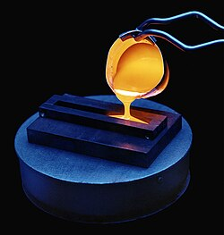
Nuclear Waste
Source: Wikipedia - Radioactive waste
Spent fuel
  ~27 tonnes/yr per 1,000 MW reactor; >250,000 tonnes stored worldwide
  Hot, highly radioactive - needs cooling and shielding
  Often encased in glass through vitrification
  Cs-137/Sr-90 (30-yr half-life) + Pu-239 (24,000-yr half-life)
  >95% of total radioactivity from nuclear power waste
  Deep geologic repository favored (e.g. Finland's Onkalo, ~2025); dry casks/pools meanwhile
Manufacturing/industrial byproducts
  Radiography sources, oil-well logging isotopes
  Alpha/beta/neutron/gamma emitters - varies by isotope
Nuclear medicine
  Mostly short-lived isotopes (e.g. Tc-99m) - decay fast
  Some longer-lived: Cs-137 (30 yr), Co-60 (5.3 yr)
  Often just held to decay, then disposed as normal waste
Rare earth mining (NORM)
  Thorium, radium in tailings/waste rock
  Slightly radioactive - alpha emitters from U/Th decay chains
  Regulated less strictly than reactor waste despite similar risk
Nuclear weapons waste
  Alpha-emitting actinides: Pu-239, Am-241 (432-yr half-life)
  Long half-lives, high biological persistence
  US: stored at WIPP (Waste Isolation Pilot Plant, NM) in deep salt beds
Vitrification of waste into glass for long term storage.
Claude organized this slide

Slide 31
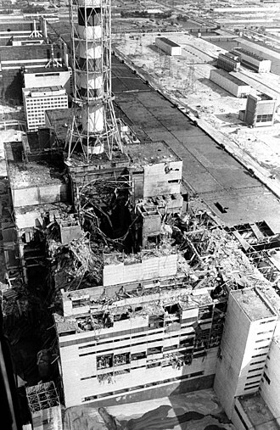
Catastrophes
Church Rock uranium mine spill : 1979
  Church Rock, New Mexico (on Navajo Nation land)
  United Nuclear Corp. tailings dam breach
  ~94 million gallons radioactive liquid + ~1,100 tons solid tailings into Puerco River
  Largest radioactive release in US history by volume (> Three Mile Island, same year)
Three-Mile Island : 28 March, 1979
  Londonderry Township, PA
  Stuck relief valve, partial core meltdown, operator error
  INES level 5 - no direct deaths, no confirmed long-term cancer link
Chernobyl : 26 April, 1986
  Pripyat, Ukraine (then the Ukrainian SSR)
  Flawed reactor design + power surge -> explosion, fire
  INES level 7 (highest) - 28 acute radiation deaths
  WHO est. ~4,000 eventual cancer deaths; some estimates up to ~1 million
Fukushima : 11 March, 2011
  Okuma, Fukushima Prefecture, Japan
  Earthquake + tsunami -> lost backup power -> triple meltdown
  INES level 7 - 1 officially recognized radiation-linked worker death
  No significant public radiation death toll expected; evacuation stress was the major health impact
By IAEA Imagebank - 02790015, CC BY-SA 2.0

Slide 32
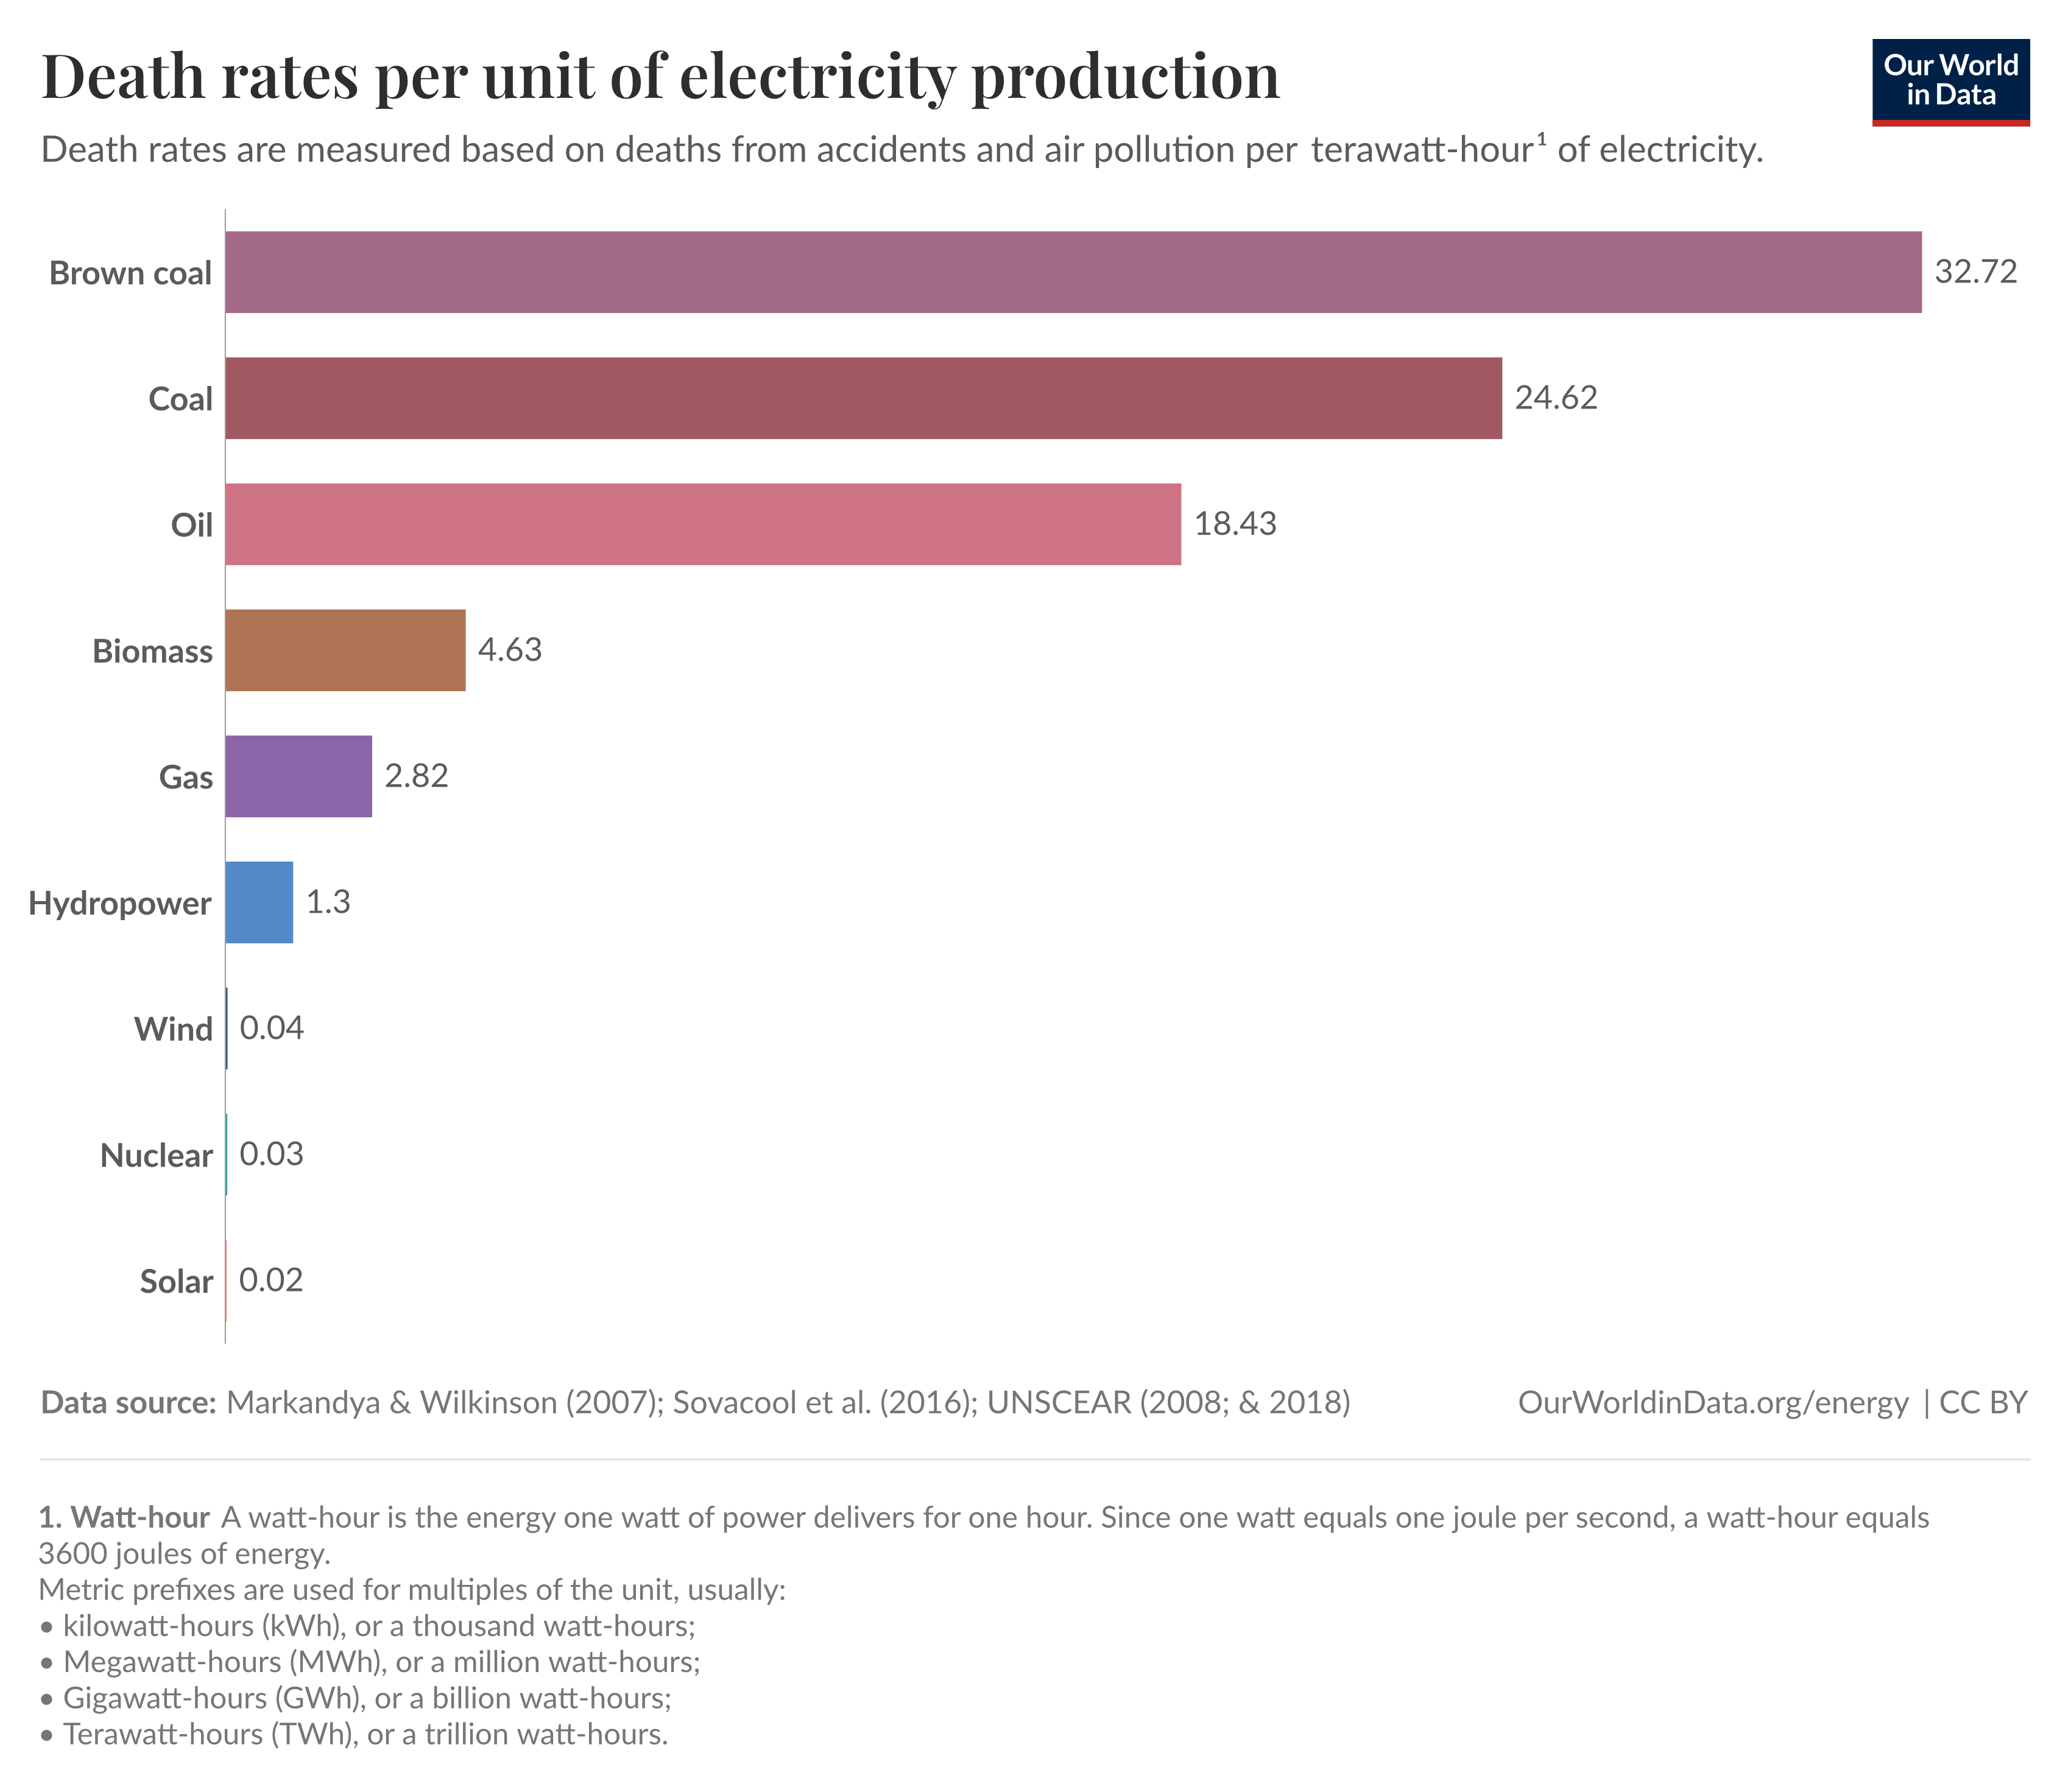
Which energy actually kills people?
Measured as deaths per unit of energy, coal and oil are by far the deadliest, mostly from air pollution
Nuclear, wind, solar, and hydro are among the safest
This surprises almost everyone! Follow the data, not the vibe
Source: Our World in Data, from Markandya & Wilkinson (2007, The Lancet) and Sovacool et al. (2016)
Notes:
Sources: Our World in Data — death rates per TWh; originals: Markandya & Wilkinson (2007, The Lancet); Sovacool et al. (2016). The peer-reviewed studies are the anchor.

Slide 33
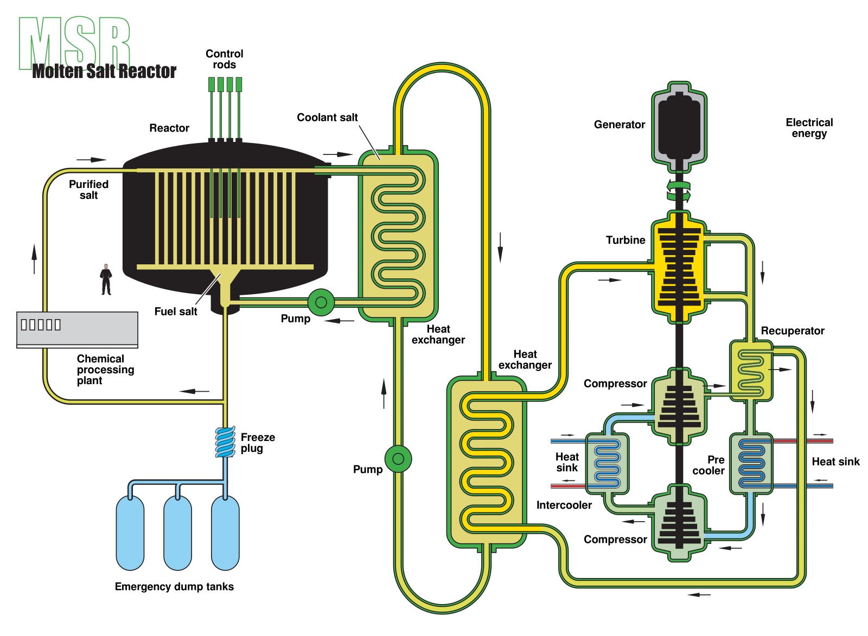
Gen 4 Reactors
Features:
  passive safety,
  far better fuel use (100–300× more energy per kg of uranium), or even closed-loop
  waste dangerous for centuries rather than millennia or eliminated altogether
  stronger proliferation resistance
Molten-salt reactor (MSR) — fuel is dissolved in a liquid fluoride/chloride salt that also serves as coolant; high temperature, low (near-atmospheric) pressure
  A passive “freeze plug” melts open on overheating, draining fuel salt into a safe, subcritical tank
  Demonstrated at Oak Ridge's Molten-Salt Reactor Experiment, 1965–1969 (7.4 MWth, 635–663°C)
Sodium-cooled fast reactor (SFR) — liquid-sodium-cooled, metallic fuel; consumes transuranic waste while breeding new Pu fuel
Very-high-temperature reactor (VHTR) — graphite-moderated, helium/salt-cooled, ~1,000°C outlet for hydrogen production
Gas-cooled fast (GFR), lead-cooled fast (LFR), and supercritical-water-cooled (SCWR) round out the six designs; SCWR alone reaches ~45% efficiency vs. ~33% for today's light-water reactors
Sources: en.wikipedia.org/wiki/Generation_IV_reactor · en.wikipedia.org/wiki/Molten-Salt_Reactor_Experiment
Image: “Molten Salt Reactor.svg”, US DOE NERAC — public domain — commons.wikimedia.org/wiki/File:Molten_Salt_Reactor.svg

Slide 34
Nuclear fusion?
ITER Reactor:
Tokamak generator
https://www.nuclear-power.net/nuclear-power/nuclear-fusion/
https://en.wikipedia.org/wiki/ITER

Slide 35
Nuclear fusion?
Source: Wikipedia - Nuclear fusion
  NIF (Dec 2022): first net energy gain - 2.05 MJ in, 3.15 MJ out
  ITER: plasma experiments ~2034, full D-T fusion not until ~2039
  WEST tokamak (France): sustained 90-million-degree plasma for 6 minutes
  Private sector surge: $2.6B+ funding in 2021 alone
  Key players: Commonwealth Fusion, Helion, TAE, General Fusion, Zap Energy
  Approaches: magnetic confinement (tokamak/stellarator), inertial confinement (lasers), hybrid fusion-fission
  Still developmental worldwide - commercial power likely decades away

